Slide 1
User Guide
For
Crisis Management System

Slide 2
Introduction
Crisis Management System (CMS) is to be the only system the airlines will use to efficiently manage execution of the entire crisis management activity, in event of emergency or crisis.
This application enables the airlines to
Initiate crisis and notify required staff, follow-up availability with the support team
Checklist and Demand management workflow
Log Enquiries and provide ready reference of data to support enquiries
Search for PDA and Cargo , Verify manifest
Inter and intra department communication
Crisis Closure
Archive Management

Slide 3
Using CMS Web Application

Slide 4
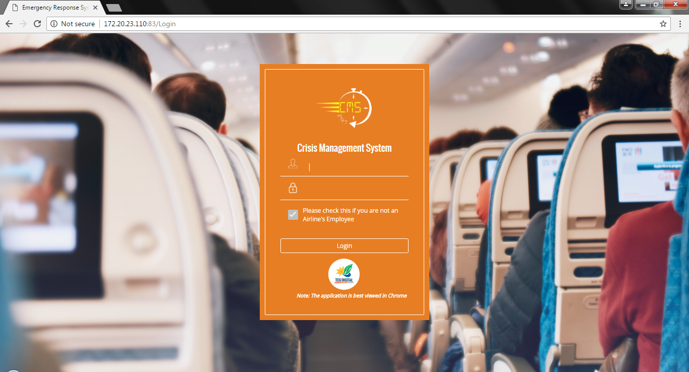
Login Page
User ID to be used for login.
For Non airlines employees logging in, this checkbox must be checked
All users using the CMS system has to log in to the system.
For employees, the users will have to enter their user id and domain password which can go through an AD authentication process.
For any non- members using this system, a separate login credential will be provided to each member by CMS admin.

Slide 5
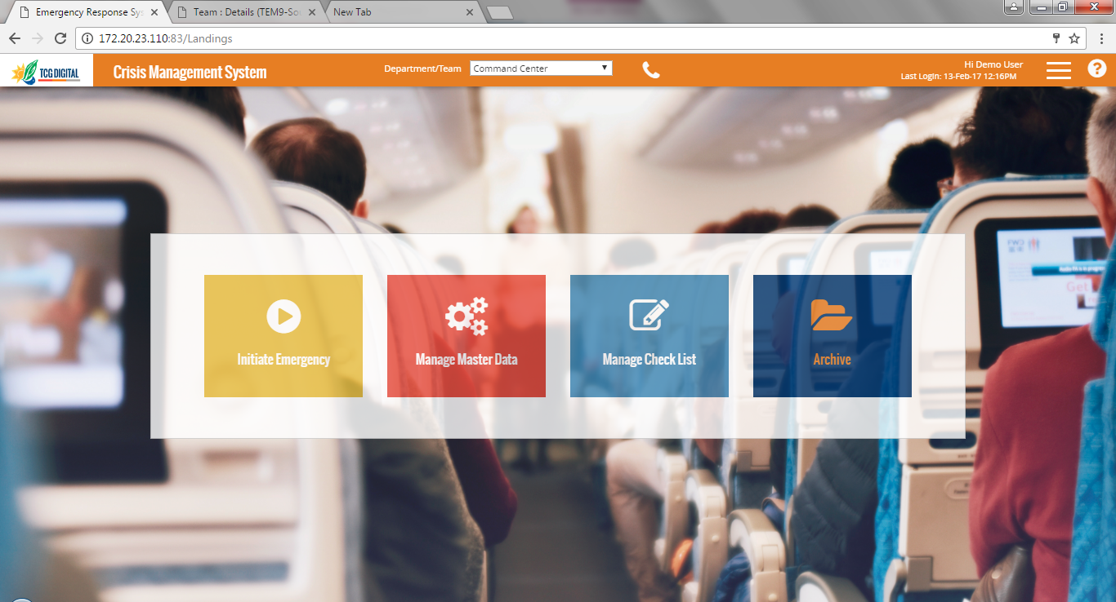
Landing Page
Banner shows
Name of user logged in
Date and Time of last login
Current department chosen
If user is mapped to multiple departments, required department can be selected from here
Hamburger menu when clicked shows the link to various other pages. Links shown are based on access rights of the selected departments
When there are no active emergencies, user will see the Landing Page
Functionalities shown on the page is based on the access rights of selected department
Clicking on any icon will take user to the corresponding page

Slide 6
Master Data Management

Slide 7
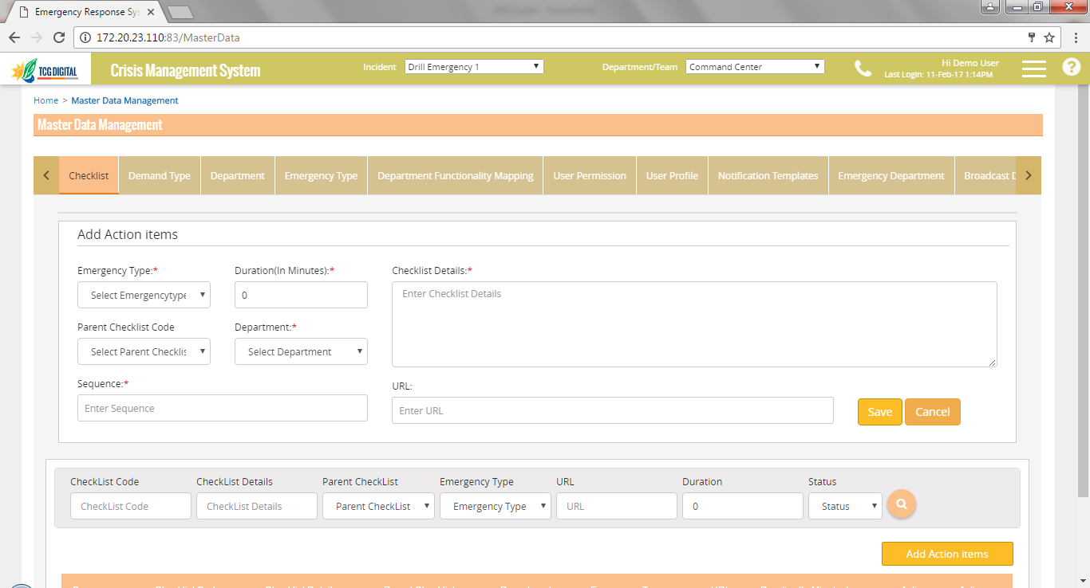
Checklist Management
The Add/Edit panel is used to add a new checklist or edit an existing one
User can filter data using the Search functionality
Grid shows the list of checklists configured for the selected department
A department can edit and view only it’s own checklists
User can add a checklist for any department and also map this to a parent checklist.
Checklist duration specifies the time within which the checklist should be completed from initiation of the emergency
Checklist code is automatically generated and cannot be edited
If any url is to be referred for the checklist, this can be updated in the URL field.

Slide 8
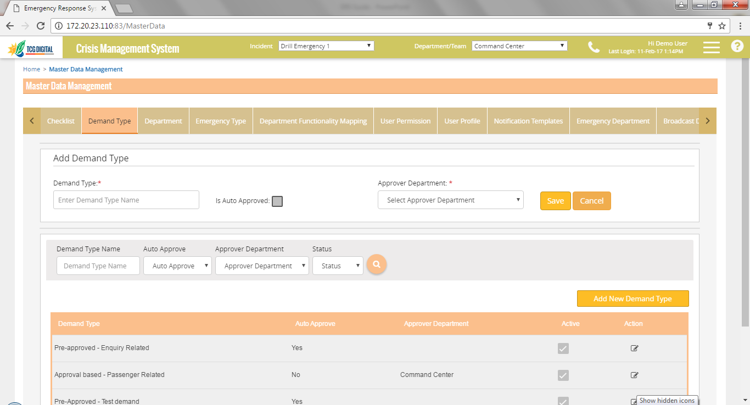
Demand Type
The Add/Edit panel is used to add a new Demand type or edit an existing one
User can filter data using the Search functionality
Grid shows the list of Demand types already configured
Master Data – Demand Type page is used to configure the Demand types.
Changes in this page has no impact on existing data.

Slide 9
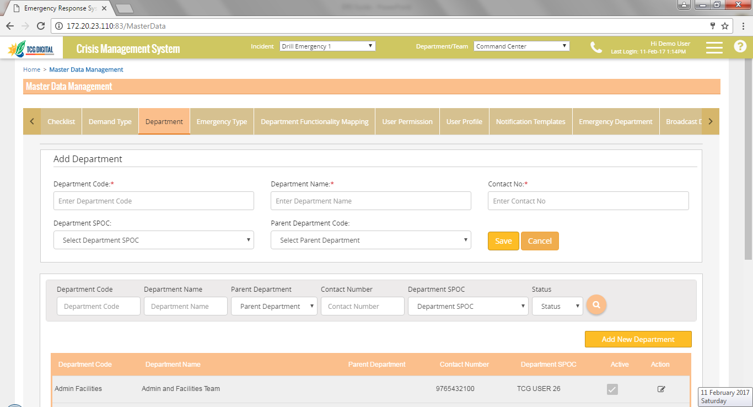
Department
The Add/Edit panel is used to add a new department or edit an existing one
User can filter data using the Search functionality
User can activate/deactivate a department by checking/ unchecking this checkbox
Grid shows the list of departments already configured
Master Data – Department page is used to manage the list of departments shown in the application.
Only active departments are shown across all applicable modules
Changes in this page has no impact on existing data.

Slide 10
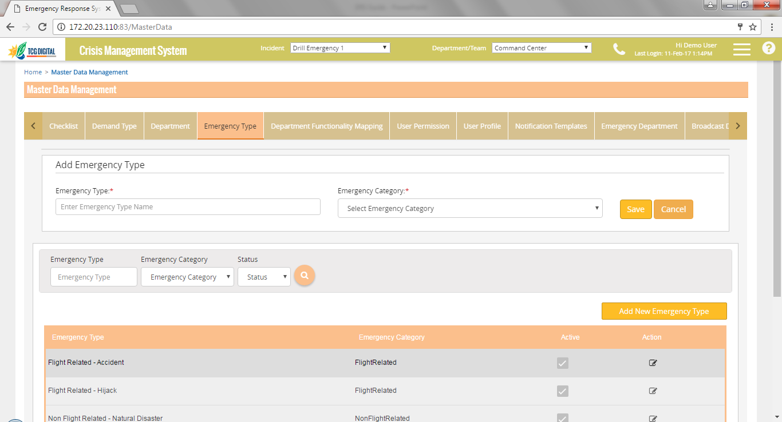
Emergency Type
User can filter data using the Search functionality
The Add/Edit panel is used to add a new emergency type or edit an existing one. Emergency category (Flight or Non Flight) can be specified here
Grid shows the list of emergency types already configured
User can activate/deactivate an emergency type by checking/ unchecking this checkbox
Master Data – Emergency Types page is used to manage the list of emergency types shown in the application.
Only active emergency types are shown across all applicable modules
Changes in this page has no impact on existing data.

Slide 11
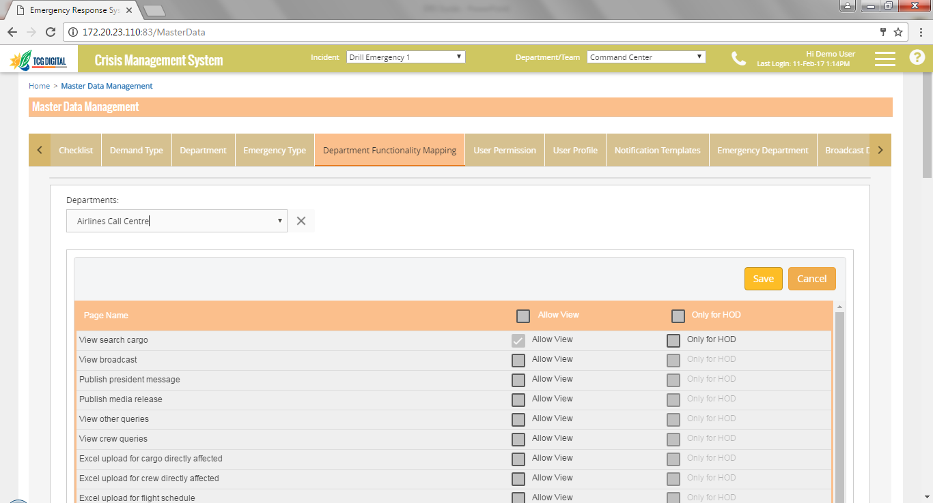
Department-Functionality Mapping
Choose the department from this list
If access is to be given only to HODs of the department for the functionality, the checkbox under “Only for HOD” column should be checked
The list of functionalities in CMS application are shown in this list
To give access to a department , check the check box against the functionality under “Allow View” column
Access rights of departments are managed through this page
Once a user logs in the application, only those functionalities to which the department has access will be available to the user

Slide 12
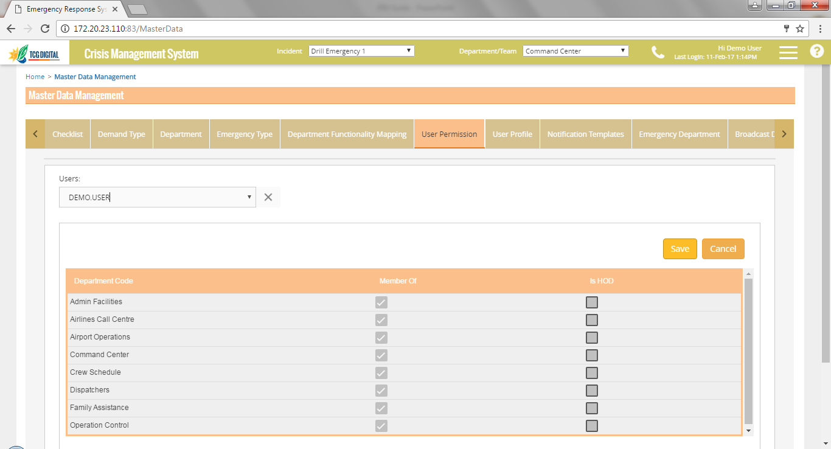
User Permissions
Choose the user from this list
To mark an user as part of the HOD group of the department, check the checkbox under “Is HOD” column
The list of active departments in CMS application are shown in this list
To map an user to a department, check the checkbox under “Member Of” column
An user can be mapped to a department using this page
An user when logged in to CMS will have access to only those departments to which he/she is mapped
An user must be mapped to at least 1 department in order to access the CMS application
HOD group consists of Head of Department, their backup and department SPOCs

Slide 13
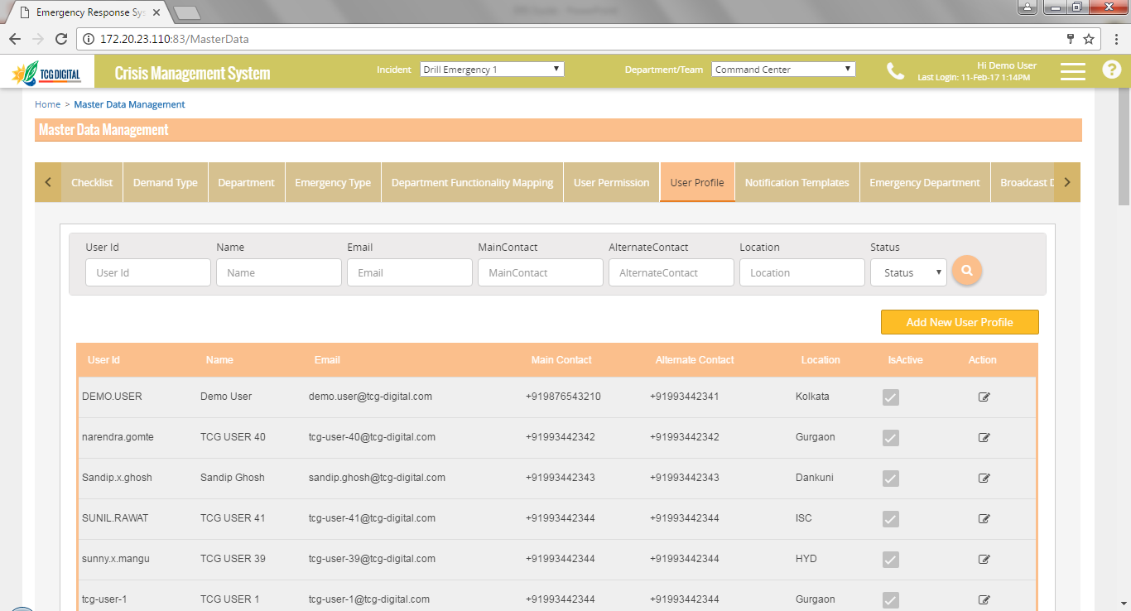
User Profile
User can filter data using the Search functionality
Click on Add to add new users
Click on Edit icon to edit an existing user
Grid shows the list of users configured in the system
Check/Uncheck the checkbox in “IsActive” column to make an user active/inactive
This page is used to manage users for CMS application

Slide 14
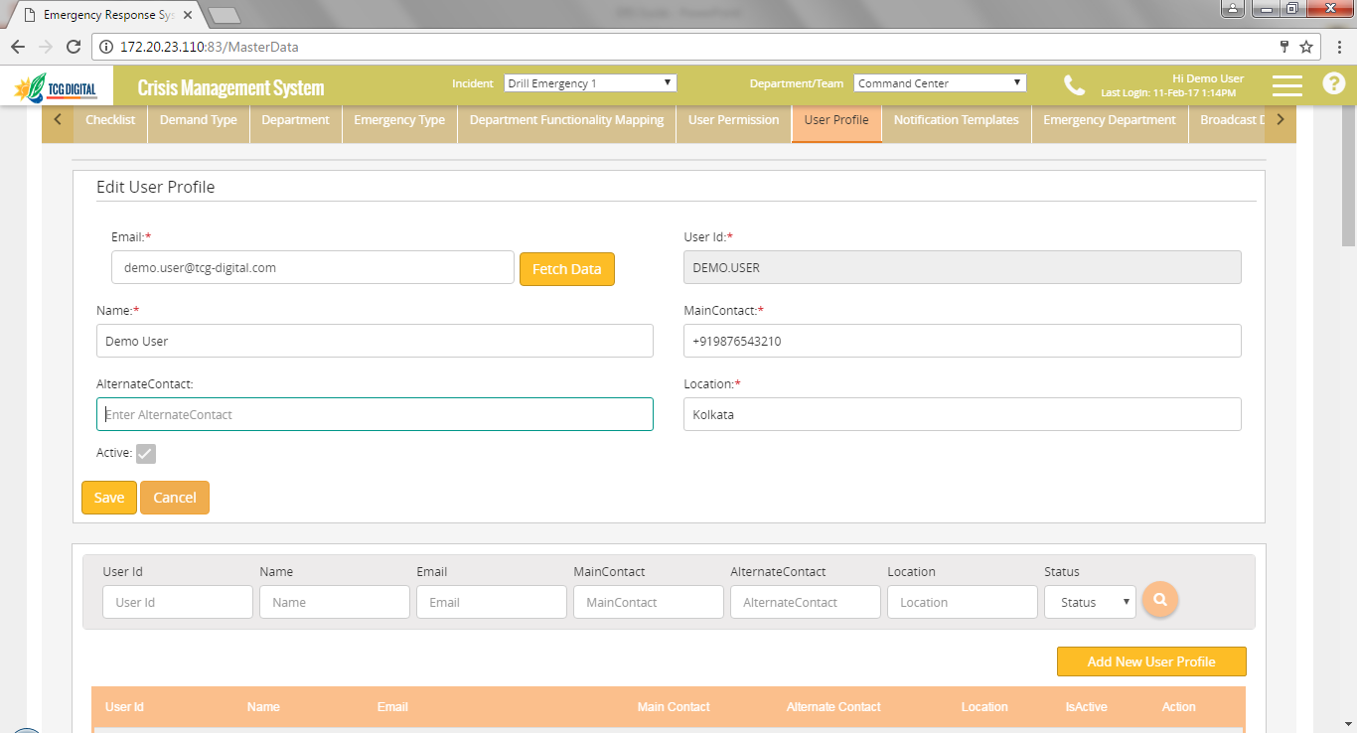
Add User Profile
For non airlines’ employees, enter data in all the fields and click on Save
For airlines employees, enter email ID and click on “Fetch Data” to retrieve data from HRMS
Check this checkbox to activate the user
When Add New User Profile is clicked, the Add user panel is shown on the top of the User Profile Screen.
A similar panel appears for editing an existing user

Slide 15
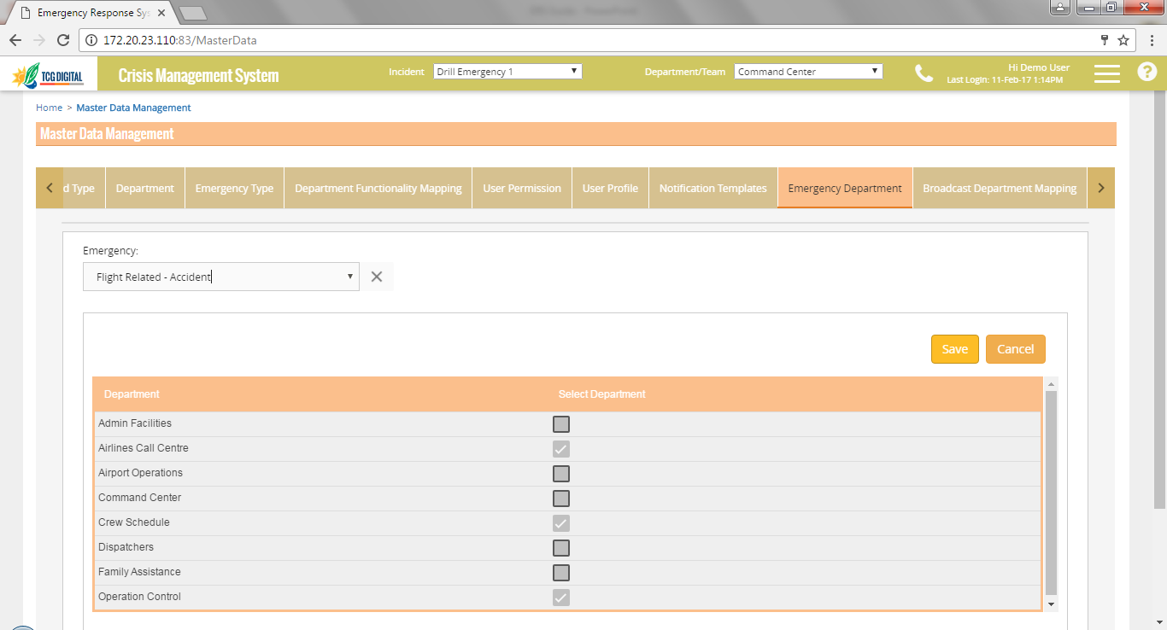
Emergency Department mapping
Choose the emergency type from this list
The list of active departments mapped to a specific emergency type
To map an emergency type to a department, check the checkbox under “Select Department” column
A department can be mapped to an emergency type using this page
An user when logged in to CMS will have access to only those departments to which he/she is mapped which are specific to the declared emergency type

Slide 16
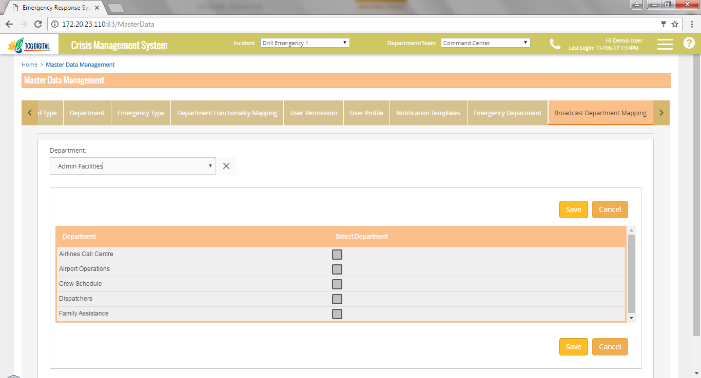
Broadcast Department mapping
Choose the department from this list
The list of active departments available
To map a department to which messages can be broadcasted, the checkbox need to be selected
A department can be mapped to an emergency type using this page
An user when logged in to CMS will have access to only those departments to which he/she is mapped which are specific to the declared emergency type

Slide 17
Emergency Initiation
All pages discussed in this section can be accessed through the hamburger menu in the banner

Slide 18
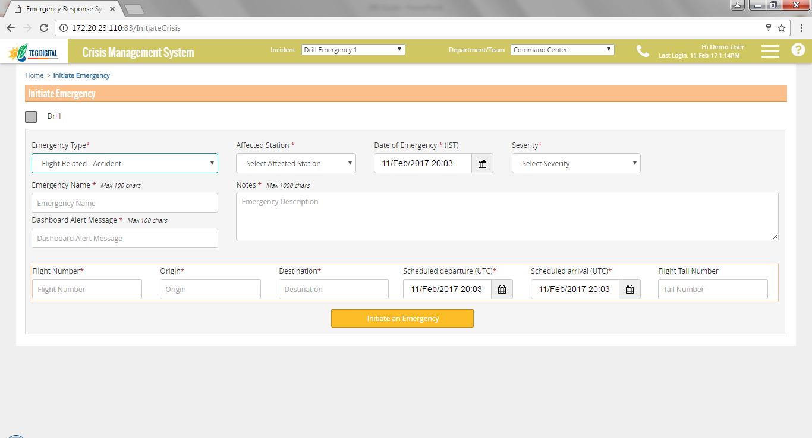
Initiate Emergency
Check this checkbox to indicate a Drill
Option to capture flight details appears for Flight related emergency types only.
User can enter the first digit of the flight number to choose the required flight
If the flight has multiple sectors, user should choose the affected sector from the Origin field, other fields will be auto populated
Once the emergency is initiated, notification messages will be sent to HOD group members of departments mapped to the emergency type

Slide 19
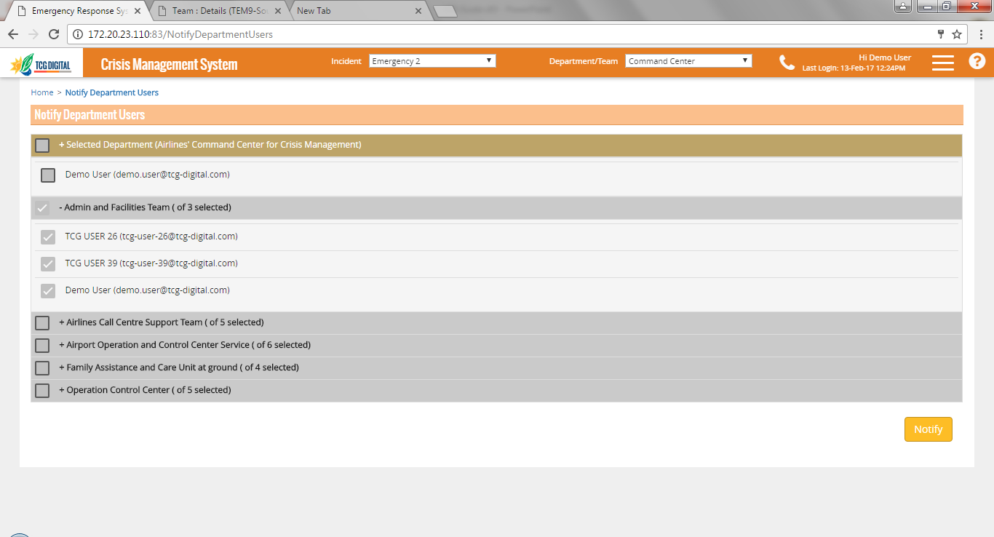
Notify Team
Check the checkbox to select team members
Click on Notify to send notifications to selected team members
Once an emergency is created, HODs can notify additional team members using this page
Email, SMS and Push notifications will be sent to the selected members

Slide 20
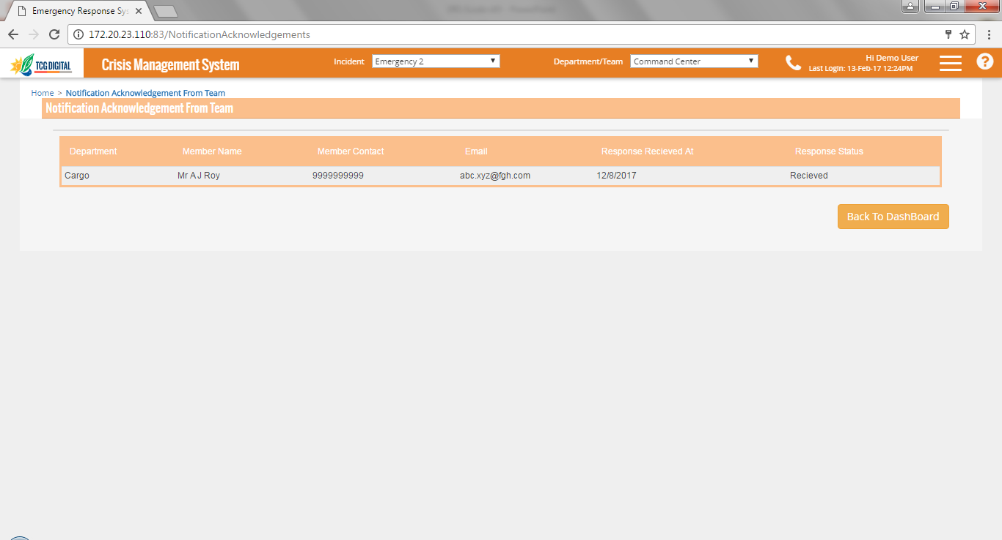
Notification Acknowledgement
Grid shows the list of team members who have been notified along with their department names
Response Status helps track the response from the team member
Team members can acknowledge their availability by responding using SMS
This page can be used to track if responses have received from team members

Slide 21
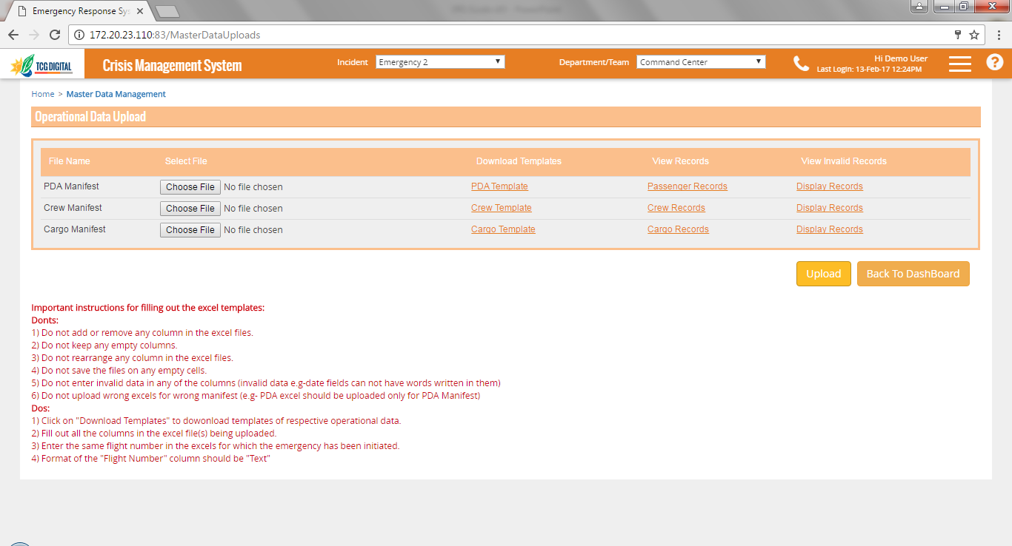
Upload Data
Click on “Upload” button to upload the data
Download the template in which data should be uploaded
On creation of a flight related emergency, all necessary data is automatically retrieved from the systems
In case services are not available, data can be uploaded using this page
Data is to be uploaded in specified format only
This page can also be used to append the available data set with additional data as required

Slide 22
Dashboard
All pages discussed in this section are specific to the emergency selected in the banner
Pages will be shown based on access rights of the selected department

Slide 23
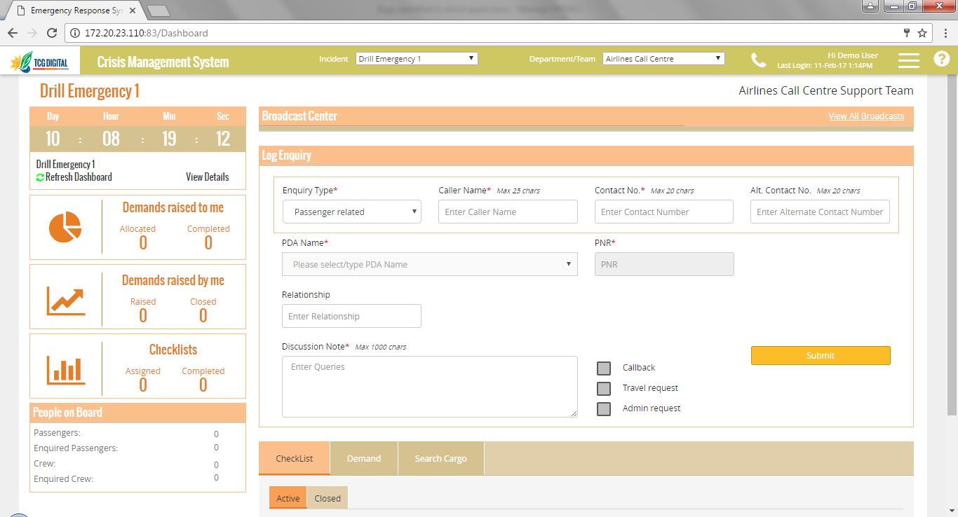
Log Enquiry for Passenger, Crew, Cargo
PNR number is populated automatically
Choose the passenger from the drop down list
If any checkbox is checked, Demands are created automatically for the required department
This section is available for Call Centre to log enquiries received from various parties for passenger, crew and cargo
Based on different enquiry type, the section shows fields to capture the necessary details
This page shows the fields to log enquiry for Passenger
Log enquiry screen for Crew and Cargo are similar, with only necessary fields shown and populated automatically

Slide 24
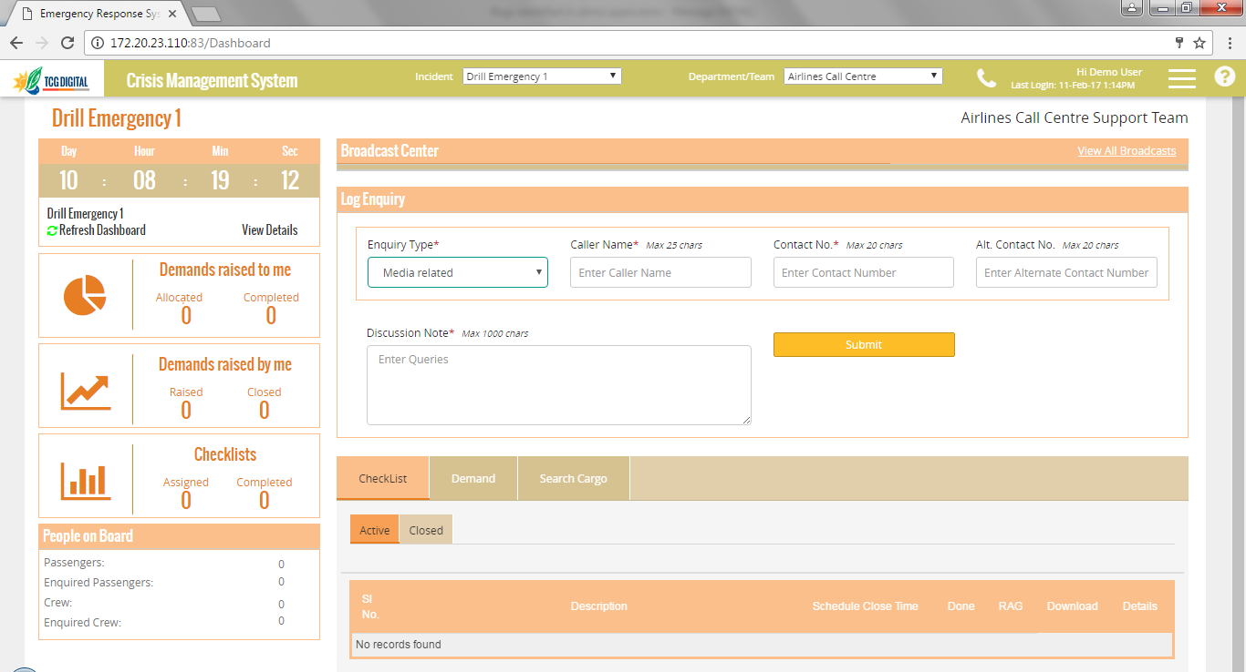
Log Enquiry for Media, others
Choose the enquiry type from this list
Click submit to log the Enquiry.
This section is available for Call Centre to log enquiries received from Media and others
Enquiries from media are categorized separately as they are addressed by specific departments that deal with sensitive data
For enquiries which do not fall in pre defined buckets, Other Queries should be selected- these quires will be handled by higher personnel

Slide 25
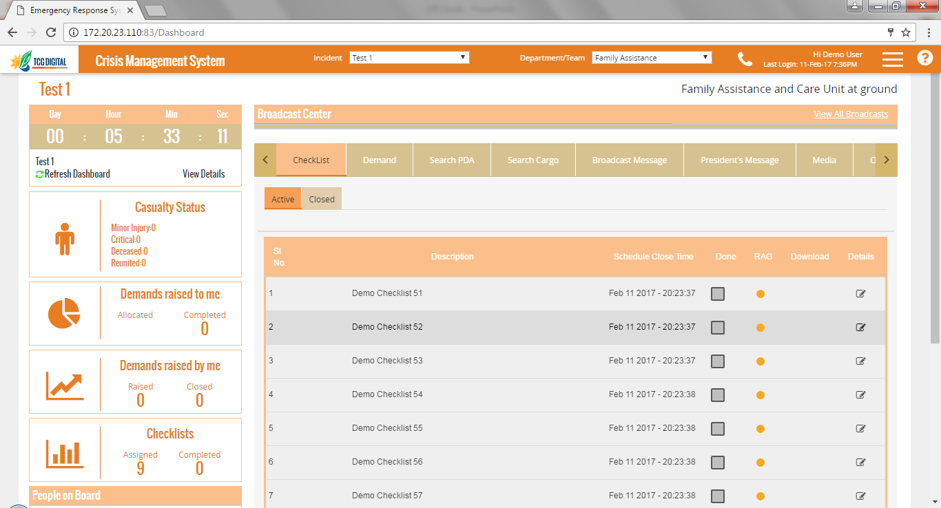
Checklists
Click on Edit icon to update comments or upload files for the checklist
List of Open checklists is shown in Active tab
List of closed checklists is shown in Closed tab
In Active tab, Click on the checkbox to close a checklist.
In Closed tab, check the checkbox to reopen a closed checklist
Parent checklists appear as Hyperlinks. Clicking on parent checklist opens the list of sub checklists with current status
RAG indicator against each checklist
This section is used to track predefined actions that need to be performed for the emergency type
Checklists shown are as per the sequence order set during configuration
Each checklist has a specified duration within which it should be closed. The RAG indicator shows the time remaining w.r.t this duration. If more than 50% of this time is left, the status is Green. If time left is less than 50%, status is Amber. If time left is zero or negative, status is Red.
Parent checklists cannot be closed manually- they get closed automatically when child checklists are closed

Slide 26
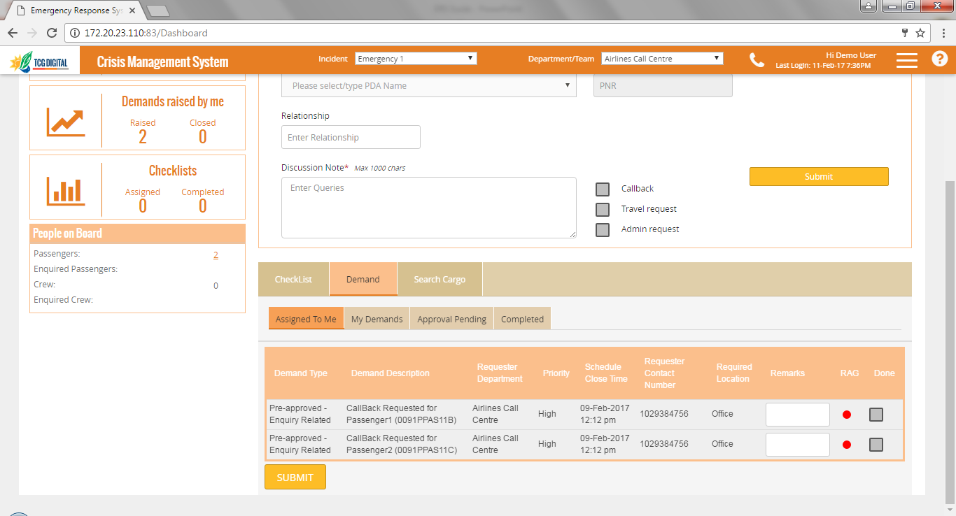
Demands – Assigned to Me
Remarks can be updated for every Demand
The checkbox in “Done” column should be checked to mark a Demand as completed
Assigned to Me tab shows all Demands assigned to that department
RAG indicator shown for every Demand
This page shows the
Each Demand has a specified duration within which it should be closed. The RAG indicator shows the time remaining w.r.t this duration. If more than 50% of this time is left, the status is Green. If time left is less than 50%, status is Amber. If time left is zero or negative, status is Red.

Slide 27
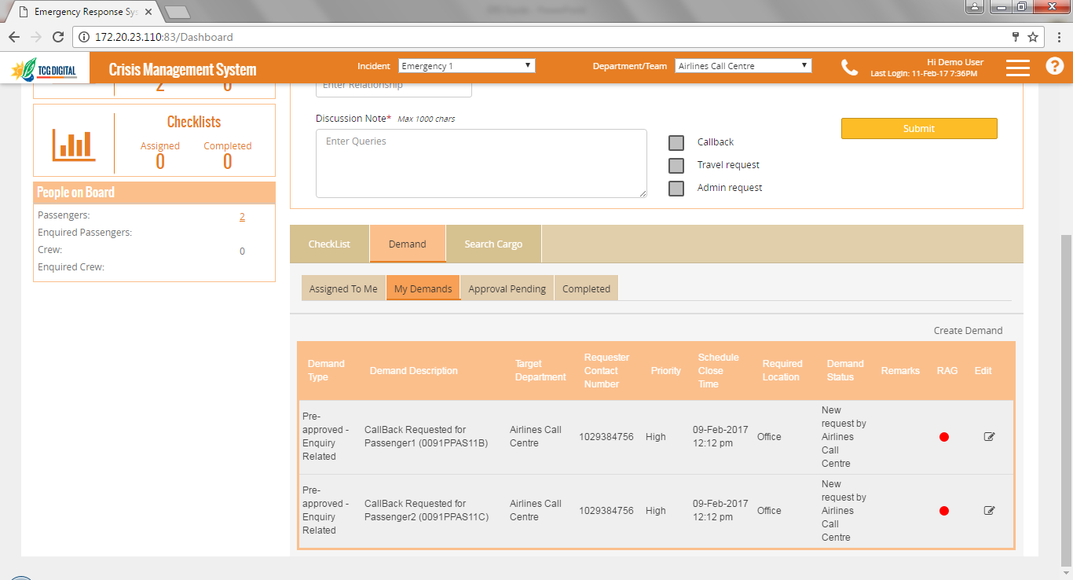
My Demands
Click on Create Demand link to create a new Demand
My Demands tab shows all Demands by that department
Click on Edit to edit the Demand. A Demand can be edited only when it is in New status
RAG indicator shown for every Demand
Demands can be raised by departments to other departments using this section
users can use the RAG status to decide if follow ups are needed on any Demand

Slide 28
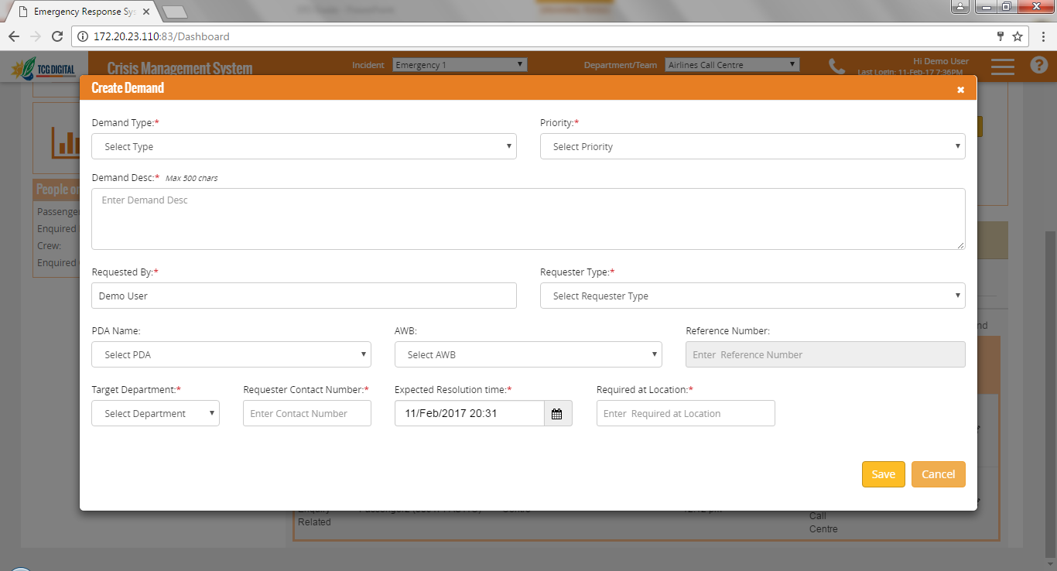
Create a Demand
Demand Type to be selected from here. Demand type selected determines if the Demand needs to be approved or is auto approved
Demand may be created for a PDA or Cargo if required
When user clicks on Create Demand, this pop up window is shown

Slide 29
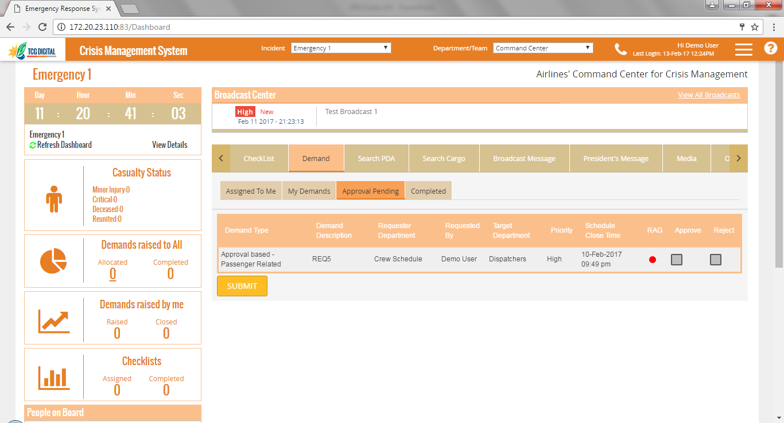
Approve Demands
This tab shows those Demands that are pending for approval
User can either approve or reject a Demand using these checkboxes
This tab is shown only to those department who have the privileges to approve Demands
When a Demand is approved, it automatically appears in the Demands -> Assigned To Me section of the target department
When a Demand is rejected, it does not get assigned to the target department and is put on Hold

Slide 30
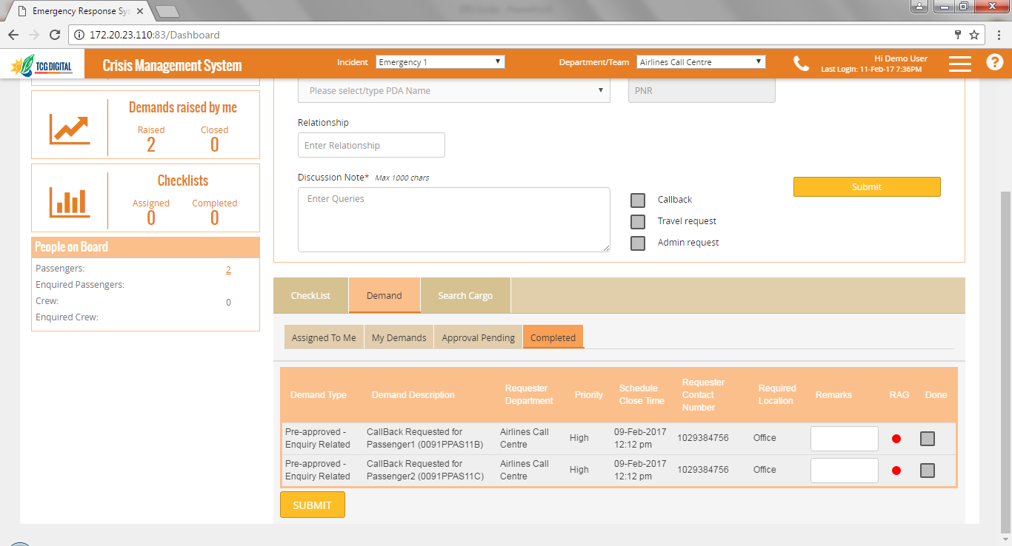
Completed Demands
This tab shows those Demands that have been completed by the target department and pending acceptance by the Demander department
User can either accept or reject a Demand using these checkboxes
When a Demand is accepted, it automatically gets closed with the current RAG status
When a Demand is rejected, it is reopened and assigned back to the target department with its current RAG status

Slide 31
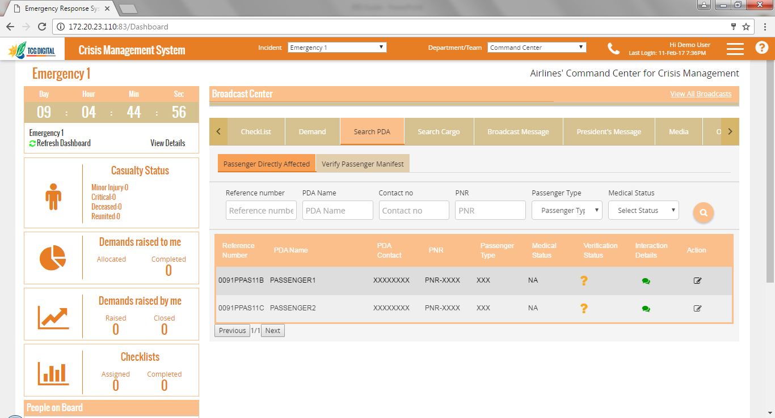
Search PDA
This should be used to view the interaction details for an affected person
Data can be filtered using Search panel
This column shows the reference number that is unique for a PDA, this is auto generated by the system
Click on this to add additional information for the PDA or change the medical status
Shows the Verification status of an affected person
This page shows the details of affected person- which includes Crew and passengers
For passengers not verified yet, the Verification status shows ?. For verified passengers, it shows a green ✓
For a PDA, icon for Interaction details appears in green if there are any interactions recorded , else it is black

Slide 32
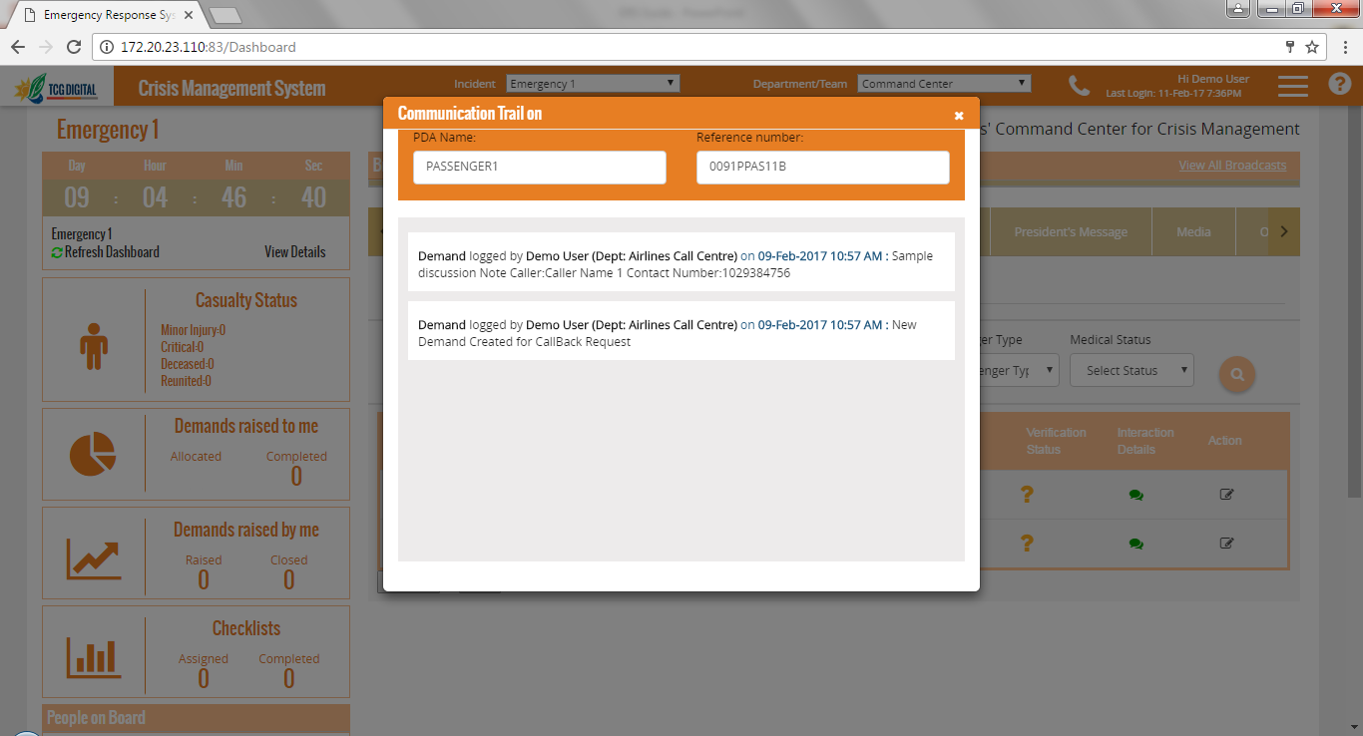
View Interaction Details
For SLT ( staff travelling as passengers), NOK (Next of Kin) details are shown, as retrieved from systems
This window shows all enquiries that have been made for the PDA, Demands logged for the PDA . Also shows updates when the Demands are closed
This popup window opens when user Interaction details icon is clicked for a PDA
Similar details are also shown for Cargo, except for NOK

Slide 33
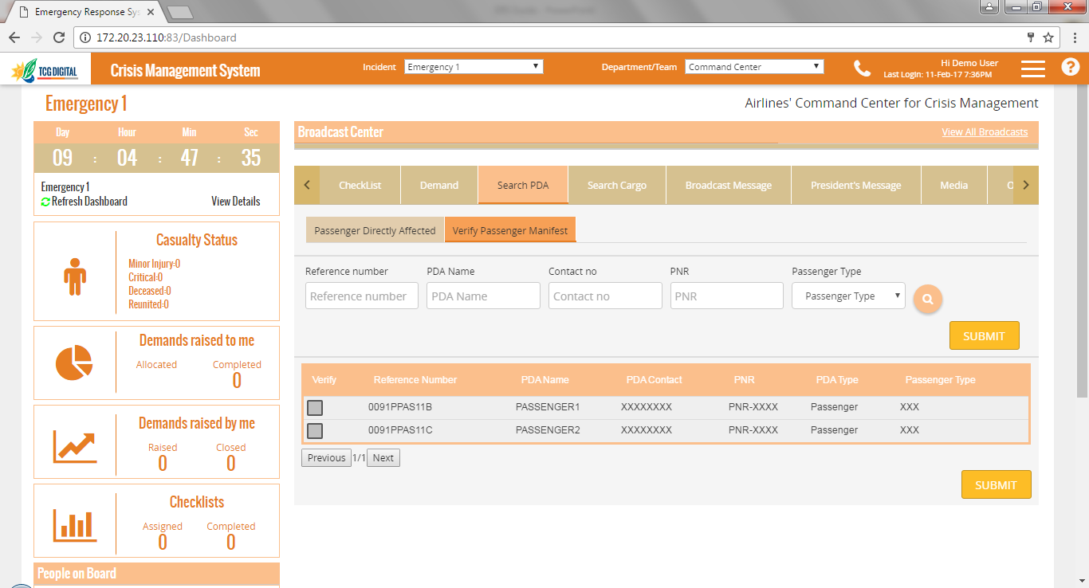
Verify Passenger Manifest
Data can be filtered using Search panel
Against a PDA, check on this checkbox and click on Submit to mark a PDA as verified
The PDA list retrieved from the integrating systems through the web services needs to undergo different offline verification before sharing the details to the persons enquiring for that PDA
This page is used to mark PDAs as verified once the verification process is complete
Similar page is available for verifying Cargo also

Slide 34
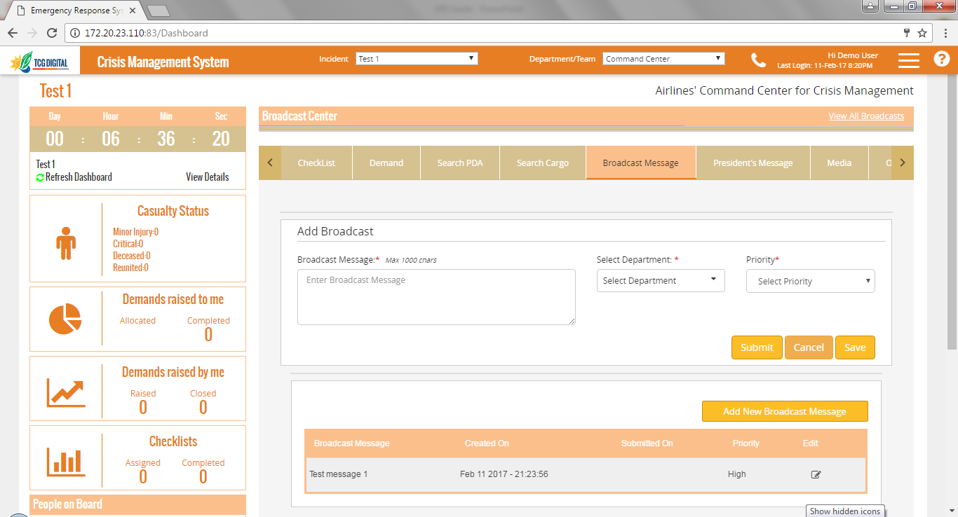
Broadcast Messages
Target department can be selected from here. One or more target departments can be selected
A new message can be added from the Add/Edit panel
A message can be saved for future use by Clicking on Save button.
Clicking on Submit button publishes the message
Grid shows the messages that have been published or saved by all departments
A message which has been only Saved, but not published yet, can be edited
This screen is used to broadcast messages to other departments or other users of the same department

Slide 35
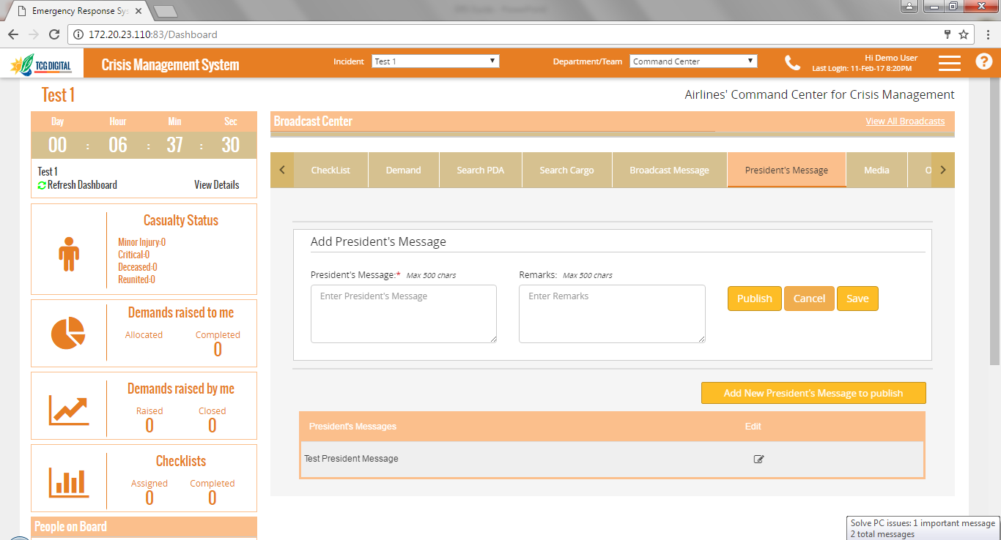
Publish President’s Message
A new message can be added from the Add/Edit panel
A message can be saved for future use by Clicking on Save button.
Clicking on Publish button publishes the message
Grid shows the messages that have been published or save
A message which has been only Saved, but not published yet, can be edited
This screen is used to publish President’s messages to all departments

Slide 36
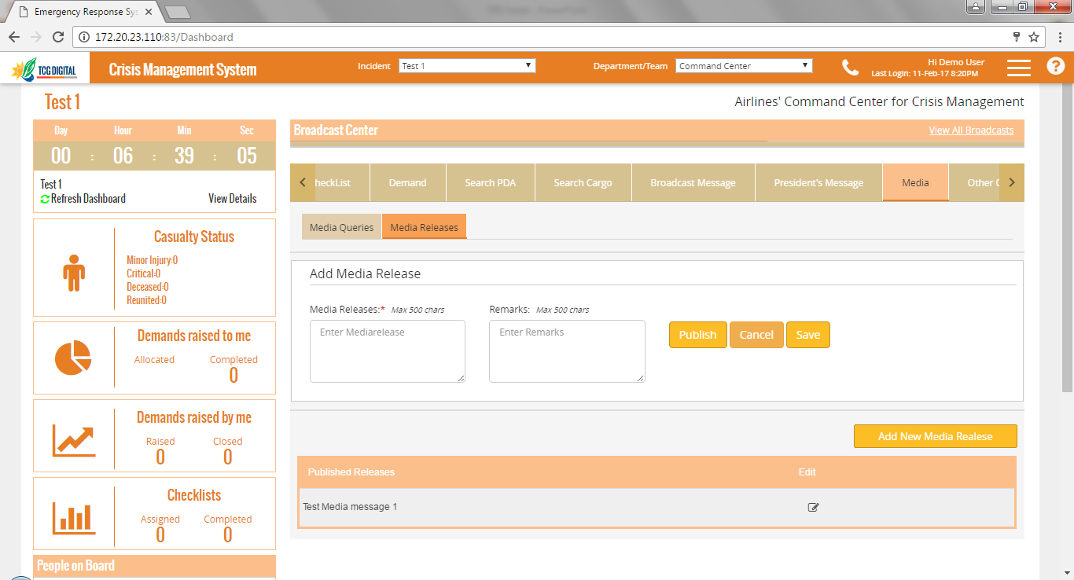
Publish Media Release
A new media release can be added from the Add/Edit panel
A media release can be saved for future use by Clicking on Save button.
Clicking on Publish button publishes the media release
Grid shows the media releases that have been published or save
A media release which has been only Saved, but not published yet, can be edited
This screen is used to publish media releases to all departments

Slide 37
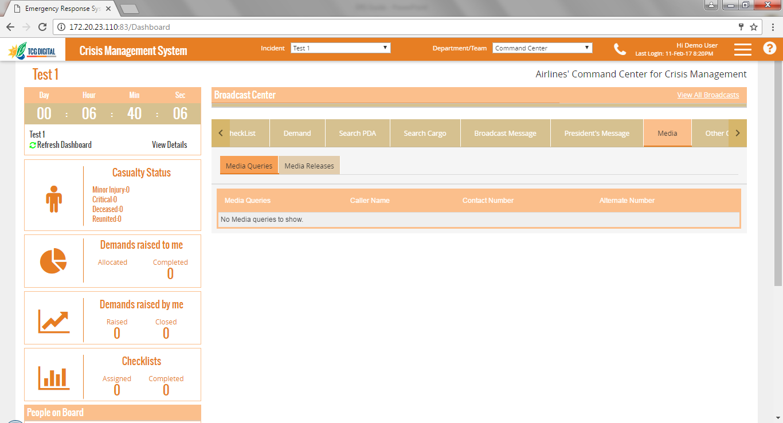
View Media Queries
Grid shows the media queries that have been logged through Log Enquiry
All queries which are logged from Media sources can be viewed from this tab

Slide 38
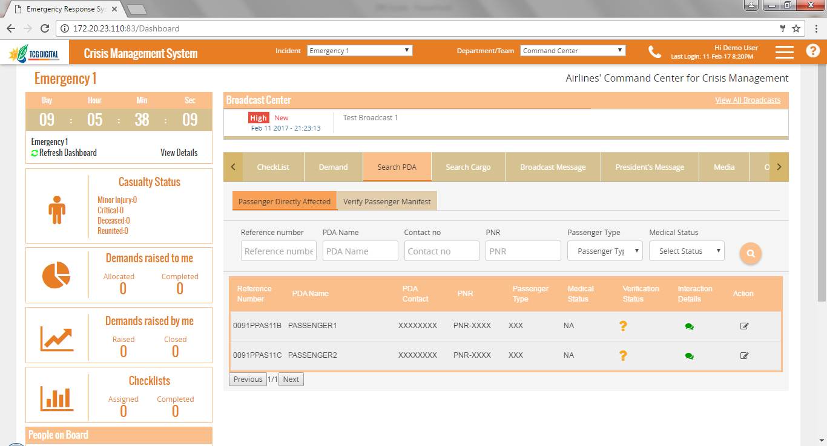
KPI Section in Dashboard
Casualty Status shows the count of passengers and crew based on medical status
Demands raised to me shows the count of Demands allocated and completed by the selected department. Clicking on Allocated count shows the details of all Demands assigned to the selected department
Demands raised by me shows the count of Demands raised and closed by the selected department
Details of passengers and crew on board can be seen through People on Board section
Checklists shows the count of checklists assigned to and completed by the selected department
KPI Section in Dashboard shows the summary of Demands and Checklists for the selected department
For few departments, casualty status is also shown
For ERC department, count of Demands and checklists shown is the consolidated count across all departments

Slide 39
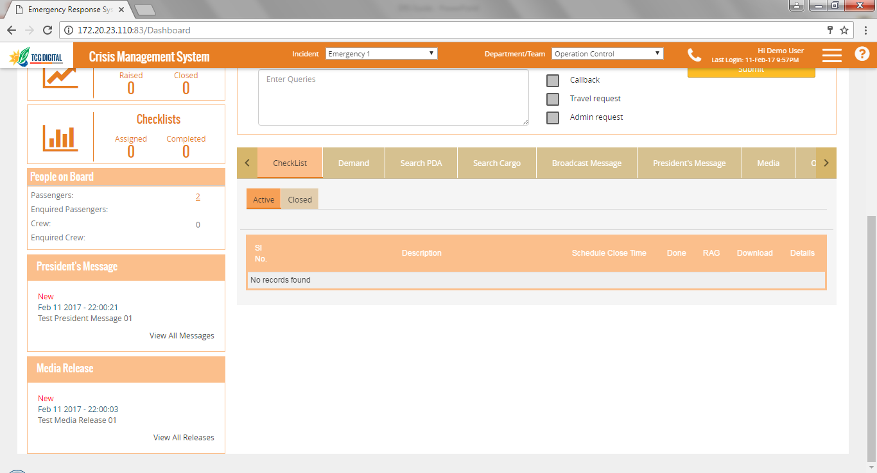
Messages Section
Broadcast Centre shows the messages broadcast to the selected department . The latest 3 messages of high priority are displayed
President’s Message section shows the latest published message from the president
Media Release section shows the latest published media release
Various messages published can be viewed from the various messages sections in the dashboard
The latest messages are shown in the respective sections
Clicking on “View All “ links in each section shows all the messages that have been published for each of the messages sections

Slide 40
Emergency Closure
Emergency Closure has 2 main sections- Department Wise Emergency Closure and closure of the Emergency itself

Slide 41
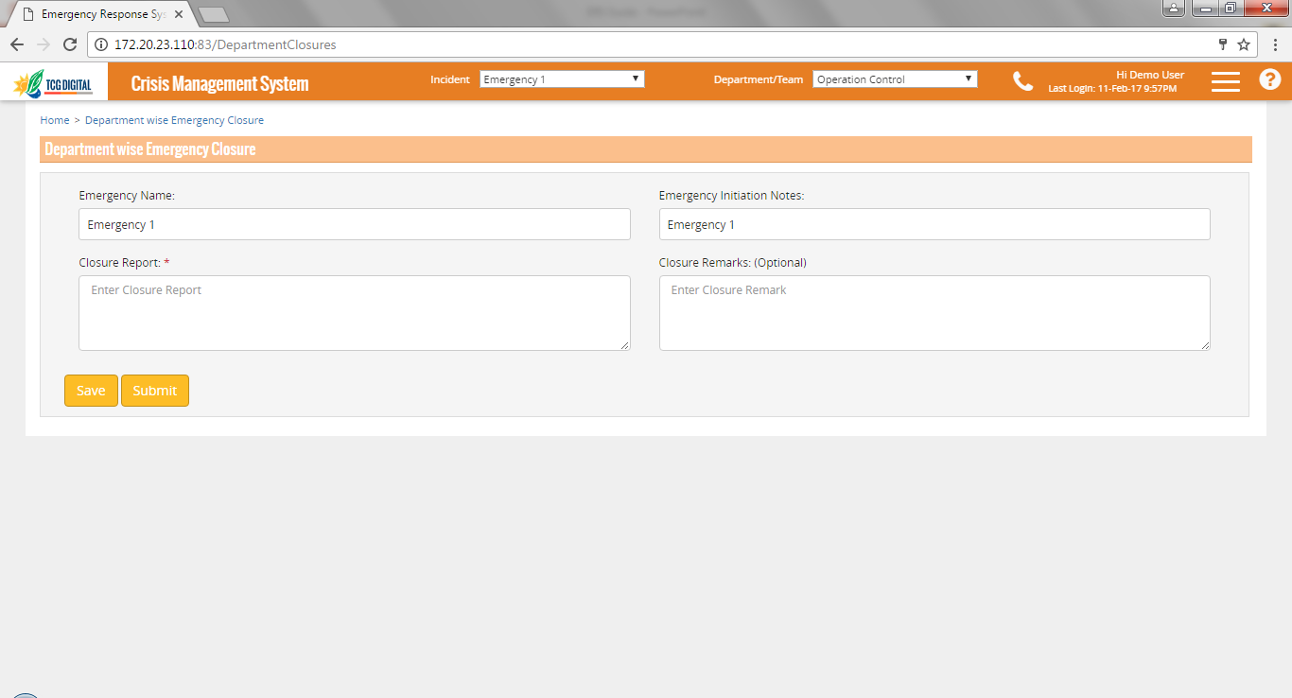
Department Wise Emergency Closure
Department wise Closure report has to be submitted prior to emergency closure
Clicking on Save just saves the data entered.
Clicking on Submit closed the emergency for that department
Department Wise emergency closure can only be done when all checklists have been completed and all Demands raised have been closed

Slide 42
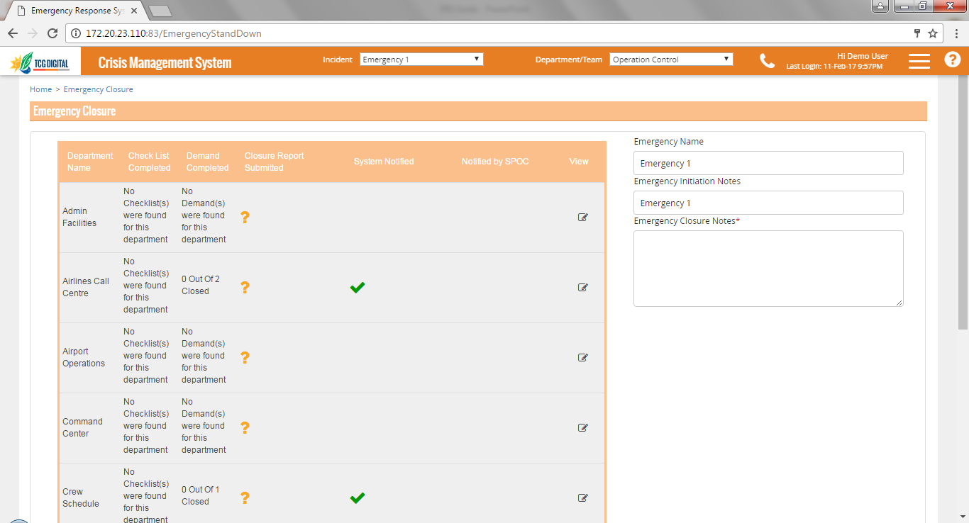
Emergency Closure
Grid shows the department wise data of checklists assigned to and Demands raised by each of the departments
Closure notes must be updated prior to closing the emergency
This column shows if the closure report has been submitted by each department
Department wise closure report can be viewed on clicking this icon
Grid also shows which departments were notified about the emergency
To close the emergency, this page is used.
Option available to save the closure notes, which can be edited before closing the emergency

Slide 43
Archives
Closed emergencies and related data can be viewed through this section

Slide 44
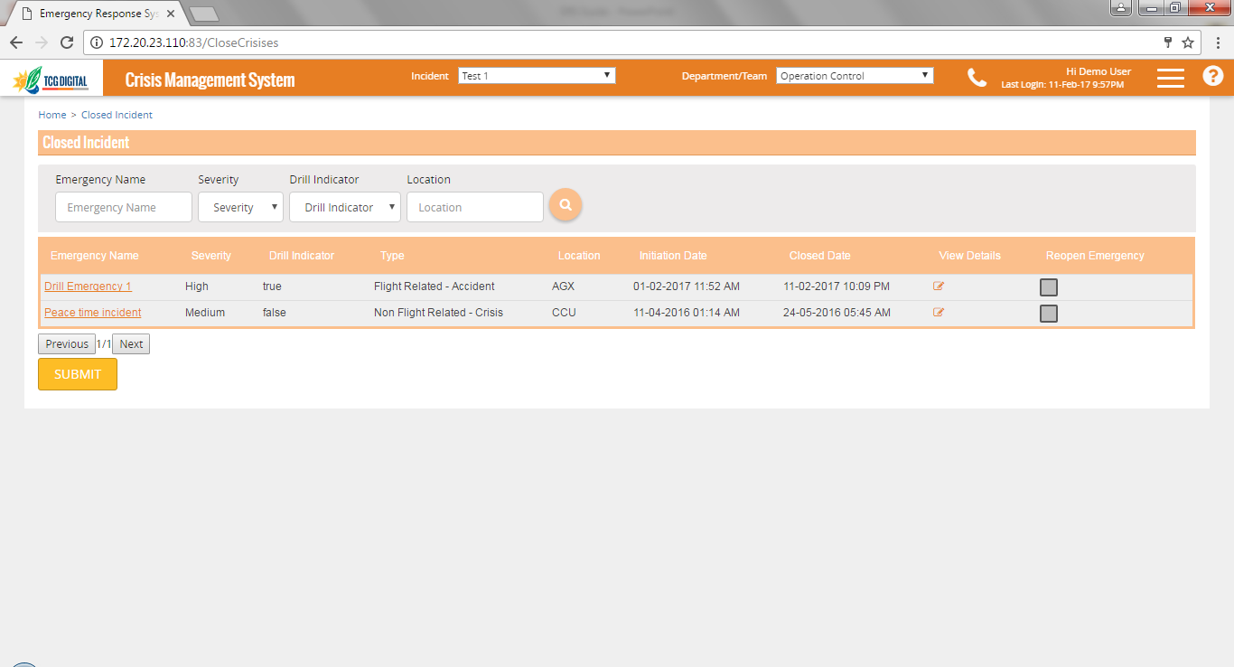
List of Closed Emergencies
User can filter the data using the Search panel
This checkbox should be checked to reopen the emergency
List of closed emergencies is shown in reverse chronological order, based on Closure Date. Clicking on the name opens the Archive Dashboard for the emergency
Details of the emergency can be viewed by clicking on this icon.
When user clicks on Archives link from Hamburger menu, this page is shown
When an emergency is reopened, departments can upload additional report for the emergency

Slide 45
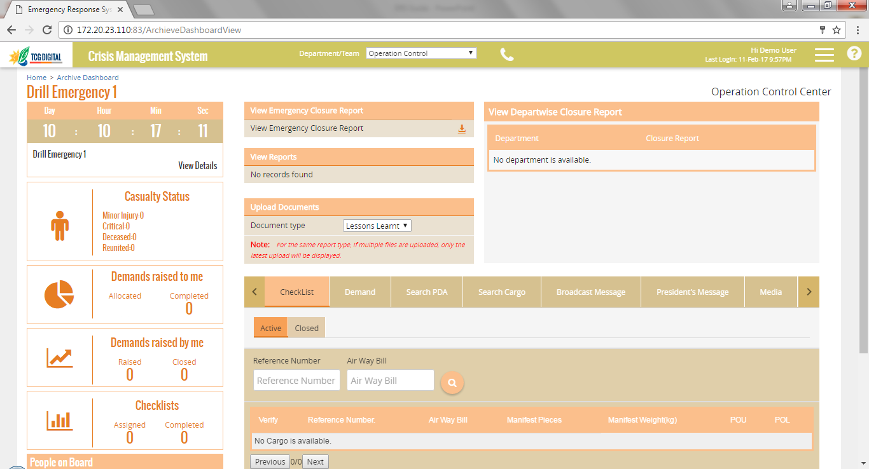
Archive Dashboard
Auto generated Emergency Closure report can be downloaded by clicking on this icon
Reports uploaded by a department can be viewed from here
Upload Documents section is available only if the emergency is reopened
Department wise closure reports shown here
Archive dashboard shows all data for the emergency
Data on this dashboard can only be viewed, this cannot be edited
Sections shown in this dashboard is based on access rights of the selected departments

Slide 46
THANK YOU

